Slide 1
Supply chain Management: AN Introduction

Slide 2
What Is a Supply Chain?
All stages involved, directly or indirectly, in fulfilling customer request.
Includes manufacturers, suppliers, transporters, warehouses, retailers and customers.
Integration of demand and supply
Within each company, the supply chain includes all functions involved in fulfilling customer request( product development, operations, marketing, distribution, finance, customer service).

Slide 3
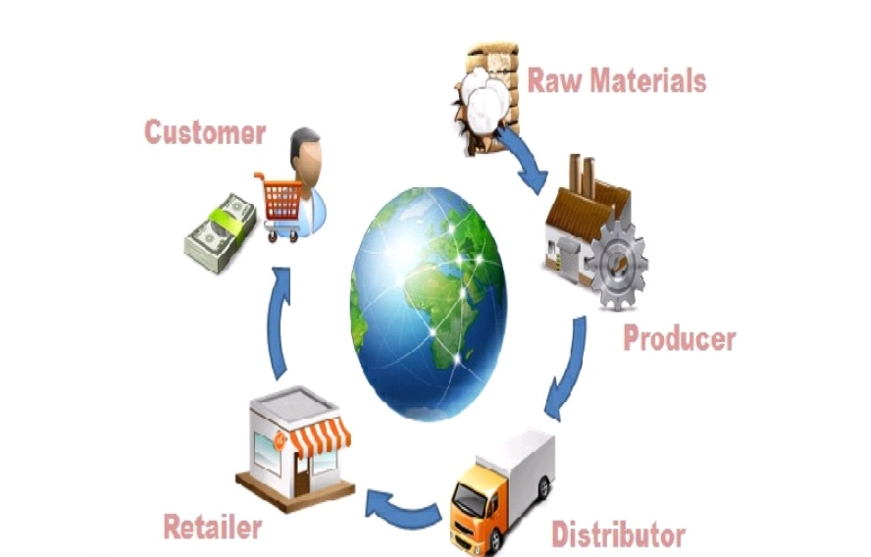

Slide 4
Customer is an integral part of supply chain
Includes movement of products from suppliers to manufacturers to distributors, but also includes movement of information, funds, and products in both directions.
Probably more accurate to use term “ supply network” or “supply web”.

Slide 5
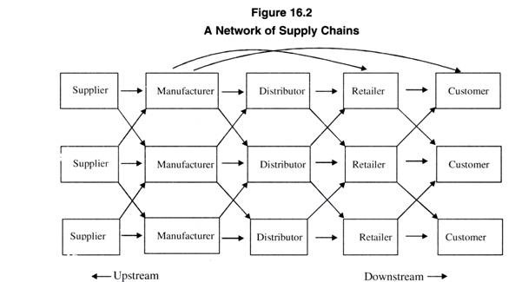

Slide 6
Flows in Supply Chain
Information
Capacity, promotion plans, delivery schedules
Material
Raw materials, in-process products, finished goods
Finance
Credits, consignment, payment terms, invoices
Suppliers
Manufacturer
Distributor
Resellers
Customers
Sales, orders, inventory, quality, promotion plans
Information
Returns, repairs, servicing, recycling, disposal
Material
Payments, consignment
Finance

Slide 7
Different types of generic supply chains
1) Manufacturer- Wholesaler-Retailer- Customer
2) Manufacturer- Retailer- Customer
e.g. Big Bazaar, Reliance chains
3) Manufacturer- Customer
e.g. BHEL

Slide 8
Stages of Detergent Supply Chain
P&G or others manufacturer
Martin’s or third party
Martin’s Supermarket
Customer wants detergent and goes to Martin’s
Chemical manufacturer (e.g., Oil Co.)
Plastic
Producer
Tenneco
Packaging
Chemical manufacturer (e.g., Oil Co.)
Paper
Manufacturer
Timber
Industry

Slide 9
The objective of a supply chain Management
Maximize overall value created
Supply chain value: difference between what the final product is worth to the customer and the effort the supply chain expands in filling the customers request.
Value is correlated with supply chain profitability( difference between revenue generated from customer and overall cost across the supply chain)

Slide 10
Example: Micromax receives Rs. 10,000 from customer for mobile phone(Revenue).
Supply chain incur costs( information, storage, transportation, components, assembly etc.)
Difference between Rs 10,000 and the sum of all these costs is the supply chain profit.
Supply chain profitability is total profit shared to be shared across all stages of supply chain.
Supply chain success should be measured by total supply chain profitability, not profits at individual stage.

Slide 11
Supply Chain Management entails:
Making decisions regarding the structure of the supply chain
Coordinating the movement of goods and delivery of services
Sharing information between members of the supply chain.

Slide 12
Evolution of supply chain management
The first revolution(Beginning of 20th century)
-The Ford supply chain
The second Revolution (Around 1960s)
-The Toyota supply chain
The third revolution (Around 1995)
-The Dell supply chain

Slide 13
Typical Supply chain
External suppliers-----Internal Functions---External distributors

Slide 14
External Suppliers
External suppliers provide the necessary raw materials, services, and component parts.
Purchased materials & services frequently represent 50% (or more) of the costs of goods sold.
Suppliers are frequently members of several supply chains – often in different roles.

Slide 15
Tier one suppliers:
Directly supplies materials or services to the firm that does business with the final customer
Tier two suppliers:
Provides materials or services to tier one suppliers
Tier three suppliers:
Providers materials or services to tier two suppliers

Slide 16
Internal Functions
Vary by industry & firm, but might include:
Processing
Purchasing
Production Planning & Control
Quality Assurance
Shipping

Slide 17
Logistics & Distribution
Logistics: getting the right material to the right place at the right time in the right quantity:
Traffic Management:
The selection, scheduling & control of carriers (e.g.: trucks & rail) for both incoming & outgoing materials & products
Distribution Management:
The packaging, storing & handling of products in transit to the end-user.

Slide 18
Vertical Integration
A measure of how much of the supply chain is controlled by the manufacturer.
Backward integration:
Acquiring control of raw material suppliers.
Forward integration:
Acquiring control of distribution channels.

Slide 19
Outsourcing
Entails paying third-party suppliers to provide raw materials and services, rather than making them in-house.
Outsourcing is increasing as many firms try to focus their internal operations on what they do best.

Slide 20
Partnering with Suppliers
Involves developing a long-term, mutually-beneficial relationship:
Requires trust to share information, risk, opportunities, & investing in compatible technology
Work together to reduce waste and inefficiency & develop new products
Agree to share the gains

Slide 21
Supplier Relationships and JIT
Use single-source suppliers when possible
Build long-term relationships
Work together to certify processes
Co-locate facilities to reduce transport if possible
Stabilize delivery schedules
Share cost & other information
Early involvement during new product designs

Slide 22
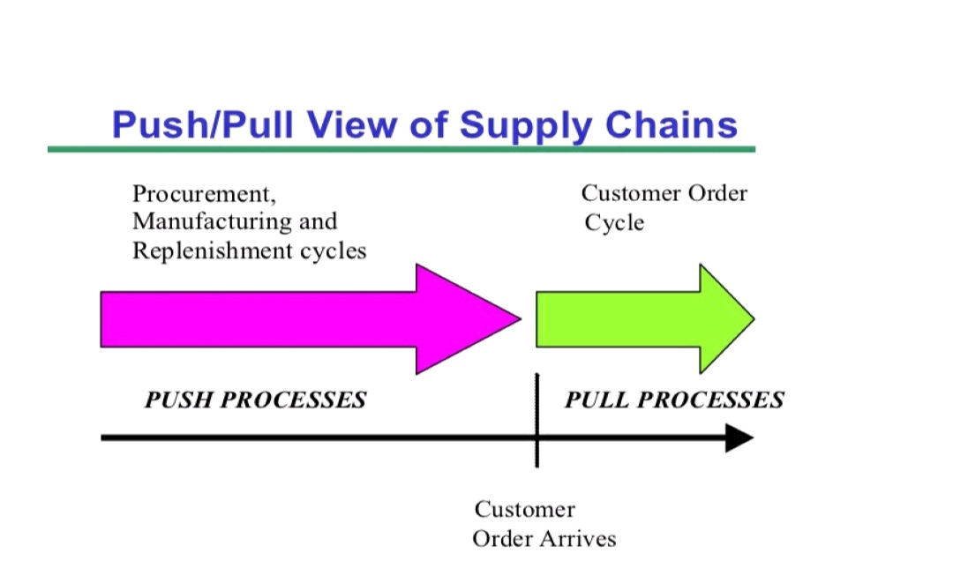

Slide 23
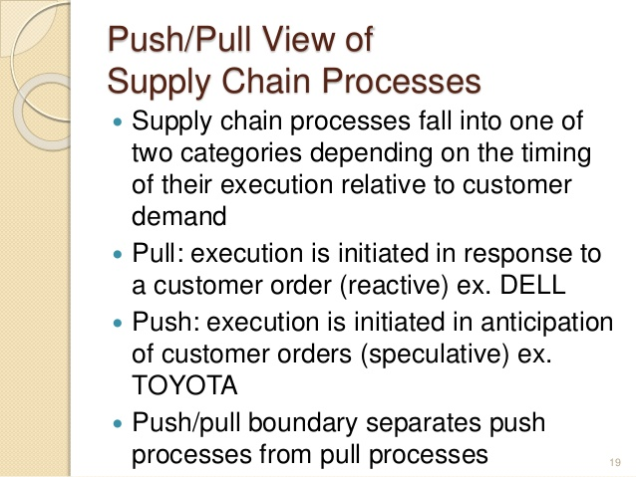

Slide 24
Information Sharing
Supply chain partners can benefit by sharing information on sales, demand forecasts, inventory levels & marketing campaigns
Inaccurate or distorted information leads to the Bullwhip Effect
If information isn’t shared, everyone has to guess what is going on downstream.
Guessing wrong leads to too much or too little inventory:
If too much, firms hold off buying more until inventories fall (leading suppliers to think demand has fallen).
If too little, firms demand a rush order & order more than usual to avoid being caught short in the future (leading suppliers to think demand has risen).

Slide 25
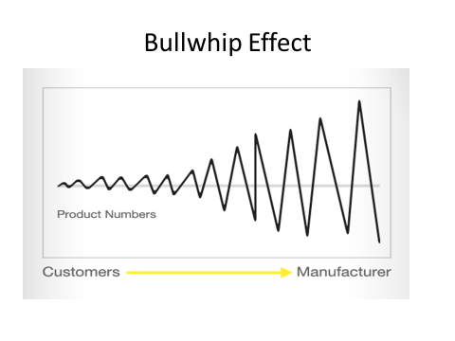

Slide 26
Short-Circuit the Bullwhip
Make information transparent:
Use Electronic Data Interchange (EDI) to support Just-In-Time supplier replenishment
Use bar codes & electronic scanning to capture & share point-of-sale data
Eliminate wholesale price promotions & quantity discounts

Slide 27
Electronic Data Interchange
The most common method of using computer-to-computer links to exchange data between supply chain partners in a standardized format.
Benefits include:
Quick transfer of information
Reduced paperwork & administration
Improved data accuracy & tracking capability

Slide 28
Ways to Reduce Bullwhip Effect
Good Demand forecasting
Information sharing
Coordination

Slide 29
Benefits of Supply Chain Management
Lower inventories
Higher productivity
Shorter lead times
Higher profits
Greater customer loyalty
Integrates separate organizations into a cohesive operating system

Slide 30
Successful Supply Chain Management
Trust among trading partners
Effective communications
Supply chain visibility
Event-management capability
The ability to detect and respond to unplanned events

Slide 31
Integrated SCM
Implementing integrated SCM requires:
Analyzing the whole supply chain
Starting by integrating internal functions first
Integrating external suppliers through partnerships

Slide 32
Amazing Supply Chain of Coca-Cola - written by Luisa Walendy
Cola is one of the most popular drinks in the world anyway and Coca-Cola one of the most famous brands. More than 1.9 billion servings of Coca-Cola are sold worldwide every day in more than 200 countries.
Coca-Cola is a global company that operates at a local level. This means that there are currently around 225 bottling partners worldwide.
The supply chain begins with the procurement of raw materials, which in the case of Coca-Cola also includes agricultural products (e.g. sugar cane or fruit) and water. The most important ingredients such as water and sugar are sourced locally, with the partners being able to choose only the type of sugar used. In Europe, mainly beet sugar is used, in Asia cane sugar and in America sugar from corn syrup.

Slide 33
One of the first steps in Coca-Cola’s supply chain is the production of the concentrate, which is mixed with water, sugar and carbon dioxide by the bottling plants. The concentrate itself is produced at other plants. According to legend, the secret recipe is kept in a safe in Atlanta. The legend also states that never more than two people should have access to it and know the exact recipe.
After mixing, the bottlers package, market and distribute the finished beverages to grocery stores, restaurants, cinemas, etc. Therefore, the management of supplier relationships and the continuous monitoring of suppliers is of great importance to the company.
With the help of technology such as warehouse automation, the company wants to continuously improve its supply chain management. Diversification and personalization of the portfolio are also important issues, which the company intends to pursue through the use of new technologies.

Slide 34
A current example of the use of new technologies in the supply chain of Coca-Cola is blockchain. As part of a cooperation with the technology company SAP, Coca-Cola wants to optimize the cooperation with its partners and the 160,000 orders per day, create more transparency and reduce costs using blockchain technology. Coca-Cola already uses an IT platform specifically for the communication of the bottlers.
Another example of innovative technologies at Coca Cola is the production of bottles from plastic waste from beaches and the sea. Nearly 300 sample bottles were produced using 25 percent recycled marine plastic. The sample bottles were developed to demonstrate the potential of improved recycling technologies.

Slide 35
These innovative processes make it possible to turn used plastic of any quality back into high-quality plastic. In the process, the components of the plastic (polymers) are broken down and impurities in the material are removed. It is then possible to reassemble the individual components (monomers) so that the resulting material is as good as new.
This means that inferior plastics, which were previously often incinerated or deposited in landfills, can thus remain in the material cycle and be used again for packaging food. This increases the amount of recyclable material in the cycle. This in turn reduces the amount of new PET and thus fossil materials needed to produce new packaging and could therefore mean strong changes for the Coca Cola supply chain.
Coca-Cola has long been a global player. Accordingly, the company is continuously optimizing and modernizing its supply chain. Due to the high sales of the soft drink, the supply chain focuses on the management of partner companies. Here, smooth communication with the partners and the subsequent smooth distribution to the points of sale play a major role.

Slide 36
The Amazing Supply Chain of McDonalds- written by Emilia Ashton
Back in 1940, brothers Richard and Maurice McDonald, founded McDonalds in San Bernardino, California, USA. Flash forward to 2022 and the fast-food giant has one of the most recognizable logos in the world and serves 68 million customers a day across 39,000 restaurants in over 120 countries and territories.
While the franchising model means that each restaurant has different owners, the menu remains almost the same no matter which McDonalds in the world is visited. This is logistically a big task and one that makes the supply chain particularly interesting.

Slide 37
The secret to McDonald’s supply chain success
Maximizing Long-term Supplier Relationships
The key to the success of McDonald’s supply chain was established by Ray Kroc, who is credited for turning the fast-food giant into one of the most successful in the world. His approach, which is still used today, relies on achieving mutual positive outcomes for franchisees, suppliers and employees.
Known as the 3-legged tool, the methodology is simple: When McDonalds succeeds so do its suppliers. The model allows the fast-food giant and its suppliers to help create value for each other rather than simply exchanging value. This therefore leads to more beneficial, long-term partnerships.
For example, one of the company’s largest distributors, The Martin-Brower Company, began by supplying paper napkins to the company’s Des Plaines, Illinois branch in 1956. Today, the supplier delivers supplies to almost all 15,000 McDonald’s locations in North America.

Slide 38
Effective Vertical Integration
Typically, a restaurant will be the final part of the supply chain and will source ingredients from third-party suppliers. McDonalds, on the other hand, is the source of its products through effective use of vertical integration. McDonalds is integrated in every stage of the supply chain through partnerships with contracted suppliers. This means that the fast-food chain processes the meat themselves, grows its potatoes and transports its own materials.
As a result of McDonald’s taking control of the component and distribution element of the supply chain, it can achieve an overall lower cost for its restaurants. The use of these vertical integration techniques is the primary reason why McDonald’s is one of the cheapest fast-food chains in the world.

Slide 39
The future of McDonald’s supply chain
Environmental Sustainability
McDonald’s is no different with the firm working on many different sustainability initiatives. For example, in 2018, the fast food giant announced that it had formed, alongside Starbucks, the NextGen Cup Consortium, which was formed to help develop both a hot and cold cup that can be completely recycled.
alongside this McDonalds have pledged that, by 2025, 100% of the fast-food chain’s guest packaging will be sourced from renewable, recycled, or certified sources.
McDonald’s plans to use AI technology to help revolutionize the way consumers use the drive-thru. The use of AI technology, according to McDonald’s, will help reduce service times and make the ordering process more efficient thus improving the overall customer experience.

Slide 40
What can cause a supply chain to fail?
Before we get into the examples, here are some reasons why supply chains can fail, according to a report published by risk management professionals Airmic:
Offshoring– meaning monitoring activity can be difficult
Increasing complexity of supply chains– causing a lack of clarity about who suppliers are subcontracting to
Cost pressures- causing companies to compromise on quality and/or ethics
Geographic clustering– making manufacturers vulnerable to a localized disaster
Modern communications– which can quickly damage reputations
Just-in-time production methods– which have reduced the time to recover from supply chain failure
Dependence on multiple suppliers– which can increase overall vulnerability.

Slide 41
Examples of supply chain fails
Boeing’s production of the 787 Dreamliner
Boeing, the American multinational aircraft producer, really sold the idea of its new 787 Dreamliner aircraft in the early 2000s. The company said it would set record production times and the aircraft would have the most revolutionary design in the history of passenger air travel. Airlines believed these promises and it became the fastest selling plane in aviation history. And, of course, Boeing had the confidence to roll out their new plane with a new and unproven method.
Boeing decided to outsource areas of its business to meet its goals cheaply and quickly. One major mistake was that it outsourced core functions, leading to a full reliance on over 50 suppliers. This meant that there was no way that the people in charge could oversee what was going on, and this led to some serious quality control issues. Planes were grounded as lithium-ion batteries were overheating and caused fires on board. The company was supposed to trial the aircraft in 2007 and then complete the first delivery in 2008, however it didn’t enter commercial service until 2011.

Slide 42
KFC’s chicken shortage
When you think of KFC, you think of chicken, right? It was therefore inevitable that the fast-food giant had to halt operations in UK due to a shortage of chicken in 2018. Over 700 of KFC’s UK stores were forced to close due to problems with its new foodservice suppliers at the time, DHL. Issues included failed deliveries and supervision problems as well as store closures.
There were numerous factors from both KFC and DHL that led to the collapse of the supply chain. Perhaps the biggest mistake KFC made was actually choosing DHL to begin with, as it had no prior experience in chilled foods and therefore lacked the expertise to fulfil this role successfully. DHL also only had one distribution center in UK, meaning all of its eggs were in one basket, which is not a sensible idea when providing for such a large company. Management issues stemming from KFC also led to the failure, such as insufficient due diligence and no contingency plans being in place.

Slide 43
Questions for continuous internal evaluation
Q 1) state the objectives and explain different components of supply chain management
Q 2) Explain 2 cases of successful supply chain management and analyze reasons behind there success
Q.3) Explain 2 cases of supply chain failure and analyze reasons behind there failure
Q 4) Explain Bullwhip effects and different ways to reduce that Bullwhip effect.

Slide 44
Thank You

